Slide 1
Faster R-cnn
Towards Real-Time Object Detection with Region Proposal Networks
Ciobota Isac-Daniel
Universitatea Politehnica Timisoara

Slide 2
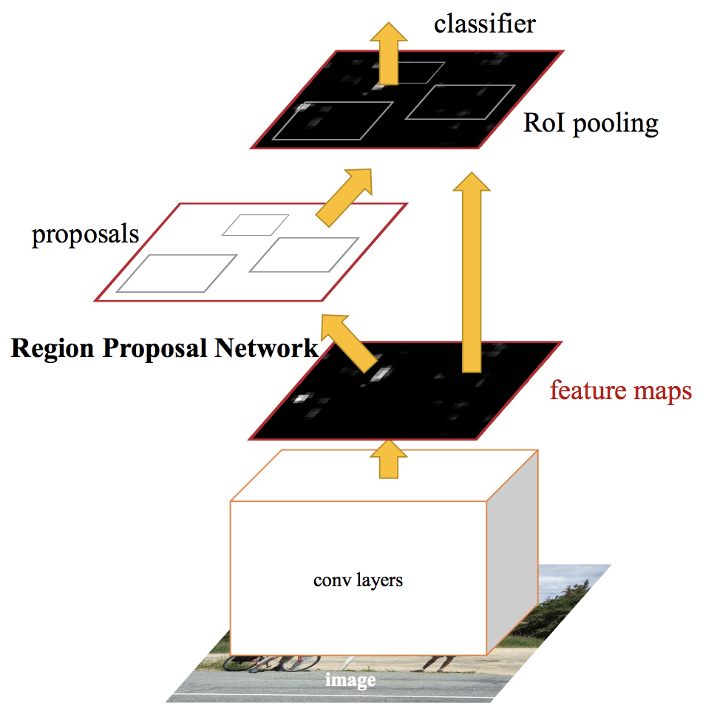
Introduction
Unified network for object detection
Enhanced version of Fast R-CNN
Uses Region Proposal Network (RPN)
Is Fast R-CNN + RPN (no external proposal)

Slide 3
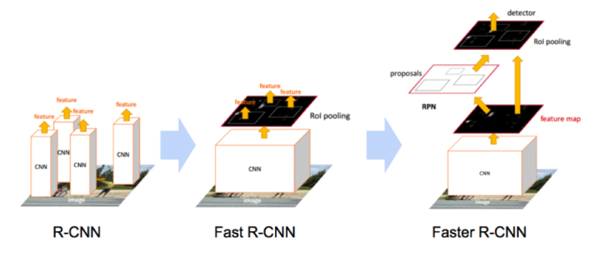
Previous Models
Selective search
Apply CNN on 2000 box proposals
Bottleneck in the Region Proposal stage
Does not use Selective search
RPN to make proposals
Anchor boxes of different sizes

Slide 4
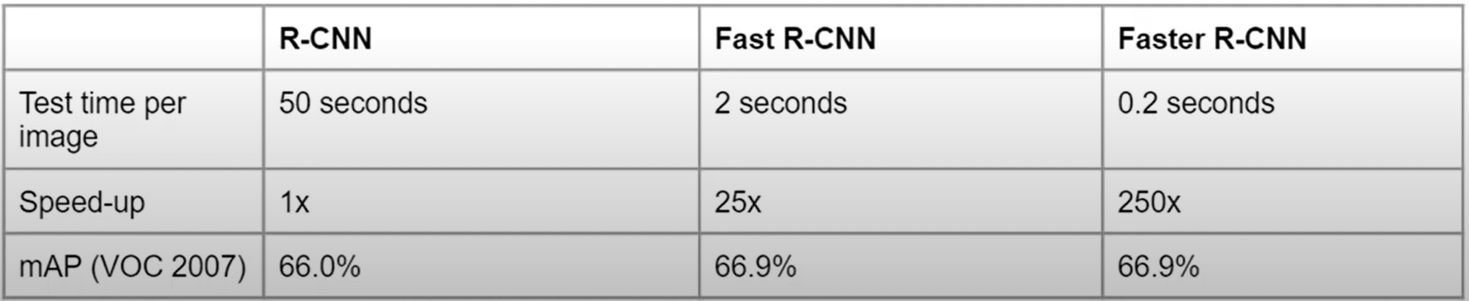
Previous Models

Slide 5
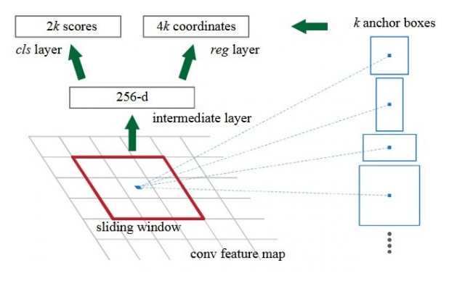
Region Proposal Network (RPN)
Conv Layer produces feature map
K = 9 (3 aspect ratios x 3 scales)
Feature Map of n x n => n x n x 9 box proposals

Slide 6
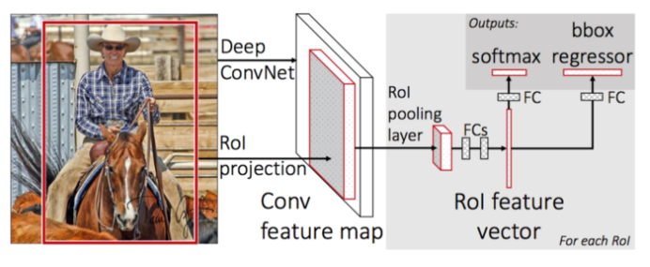
Fast R-CNN
Any backbone CNN (VGG and ZF in the paper)
RoI pooling layer
2 fully connected layers
Classifier (softmax)
Regressor

Slide 7
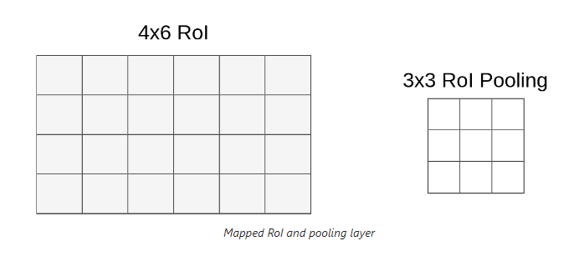
Region of Interest Pooling (RoI)
Receives box proposals as input (9 different sizes and aspect ratios)
Uses MaxPool to produce a fixed sized feature map (3 x 3 x 512)

Slide 8
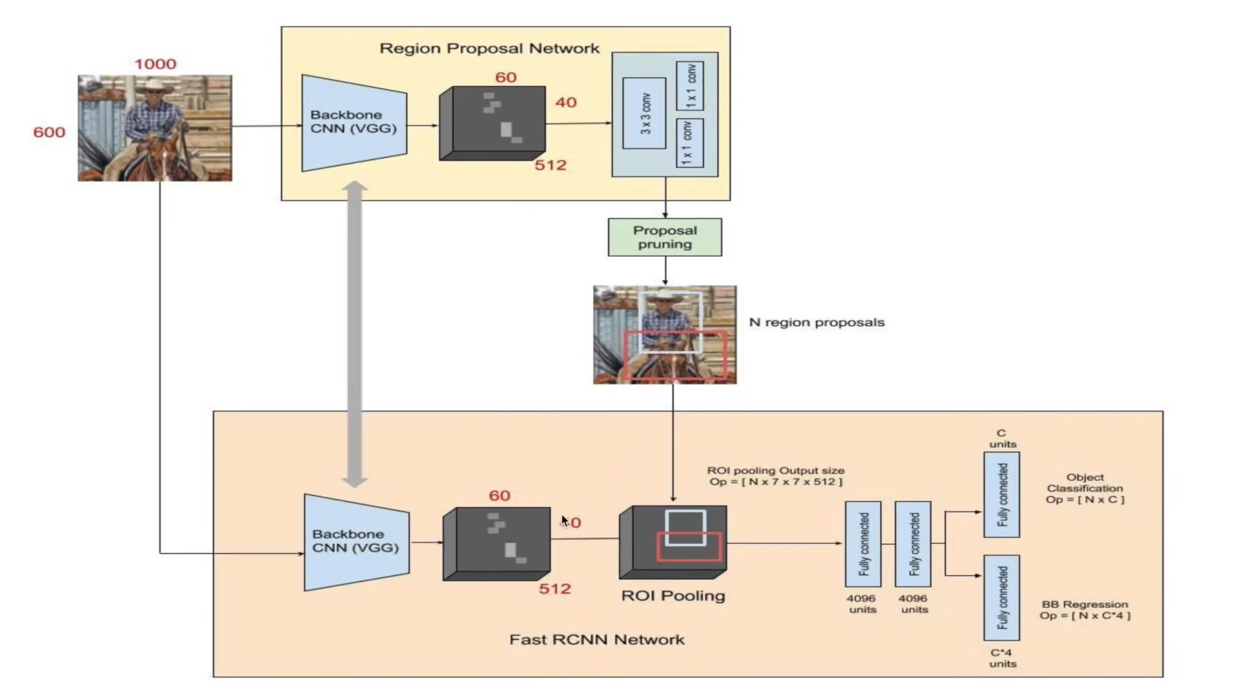

Slide 9
Training of Fast R-CNN – 4 steps
RPN trained for region proposal task
Train Fast R-CNN using the trained RPN
Use the detector network to initialize RPN training Fine-tune layers unique to RPN network
Fine-tune unique layers of Fast R-CNN
RPN and Fast R-CNN detector share the same conv layes and form a unified network

Slide 10
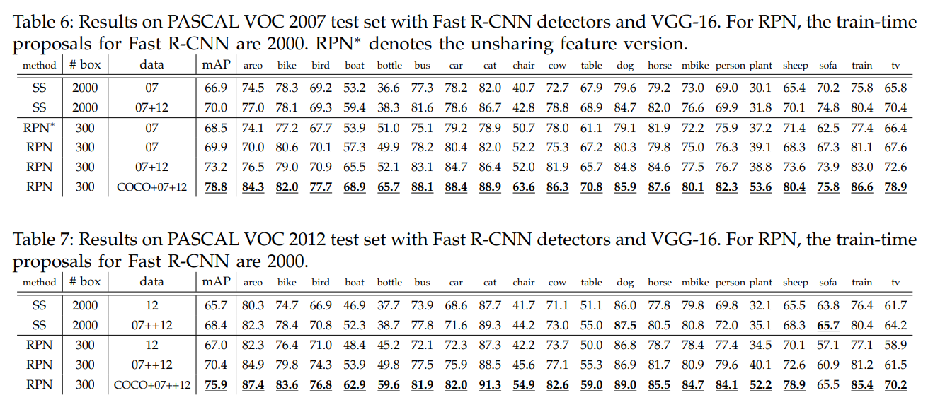
Results

Slide 11
Thank you
Ciobota Isac-Daniel
Universitatea Politehnica Timisoara

